Slide 1

PRESENTATION OF
SOFTWARE ENGINEERING & SYSTEMATIC ANALYSIS
Submitted to:
Dr. Syed Arif Islam
Assistant Professor
Department of CSE
University of Information & Technology
 | Submitted by: Shalehin Ahmed Ornob – 0432410005101083 Joy Goswami Niloy – 0432410005101069 Shamiur Hasan – 0432410005101053 Helal Uddin Patwary – 0432410005101086

Slide 2
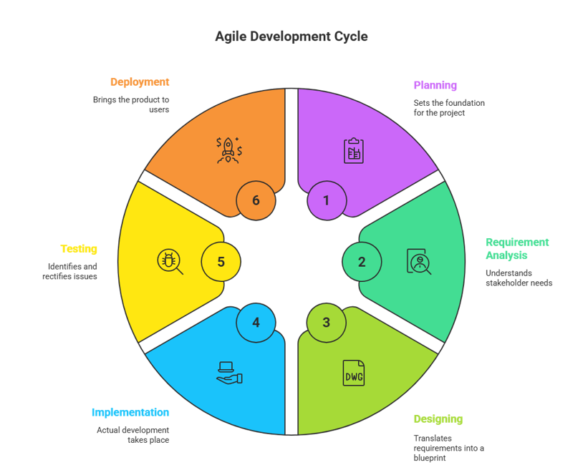
PRESENTED TOPIC:
AGILE DEVLOPMENT MODEL

Slide 3
What is Agile Method ?
The Agile Model is all about building software step by step, getting feedback, and improving continuously, instead of waiting until the end to deliver the whole system.

Slide 4
Steps in the Agile Development Model
Step1- Requirement Gathering: That defines what the software needs to do.
Step2- Design Requirements: That's creates the technical blueprint for how to build it.
Step3- Construction: This is where developers write the code to build the software.
Stepr4- Testing/Quality Assurance : This step finds and fixes bugs to ensure the software works correctly.
Step5- Deployment: This is when the finished software is released to users.
Step6- Feedback: This step collects user input to plan future improvements.

Slide 5
Agile SDLC Methods
Main Methods:
Scrum → Sprint-based, team collaboration (2–4 weeks).
Kanban → Visual workflow, continuous delivery.
XP (Extreme Programming) → High-quality code, TDD, CI.
Lean → Fast delivery, eliminate waste.
Other Supportive Methods:
TDD (Test-Driven Development),
BDD (Behaviour-Driven Development),
ATDD (Acceptance Test-Driven Development),
Exploratory & Session-Based Testing,
DSDM (Dynamic Systems Development Method),
Crystal Methodologies.

Slide 6
Principles of Agile (12 from Agile Manifesto)
Customer satisfaction by early and continuous delivery.
Welcome changing requirements, even late.
Deliver working software frequently.
Business and developers work together daily.
Build projects around motivated people.
Prefer face-to-face communication.

Slide 7
Principles of Agile (12 from Agile Manifesto)
Working software = measure of progress.
8. Promote sustainable development.
9. Focus on technical excellence and good design.
10. Simplicity is essential.
11. Best ideas come from self-organizing teams.
12. Reflect and improve regularly.

Slide 8
Characteristics of Agile Process
Flexible and adaptive to change.
Incremental development with usable output.
Continuous customer feedback.
Short delivery cycles.
Iterative evaluation of progress.

Slide 9
When to Use Agile?
When requirements are likely to change.
When fast delivery is needed.
When customer involvement is possible.
When projects need frequent updates.

Slide 10
Advantages & Disadvantages
Advantages | Disadvantages
Adaptability to Change | Less Predictable Outcome
Faster Time-to-Market | Requires High Commitment
Higher Customer Satisfaction | Lighter Documentation
Improved Quality | Potential for Scope Creep

Slide 11
Conclusion
In Conclusion,
“Agile empowers teams to deliver software quickly, adapt to change, and create solutions that truly meet user needs.”

